Slide 1
FPGA-Based Parking Monitoring System
Hardware Engineering
Team F

Slide 2
Introduction:
Objective:
Implement a parking monitoring system using FPGA
Use ultrasonic and infrared sensors for real-time status updates
Key Benefits:
High efficiency and accuracy in parking management
Real-time updates and collision prevention

Slide 3
Project Concept:
Description:
Real-time monitoring of parking spaces using sensors
FPGA processes sensor data to determine parking space status
Technologies Used:
Field-Programmable Gate Arrays (FPGAs)
VHSIC Hardware Description Language (VHDL)
KiCAD for PCB design

Slide 4
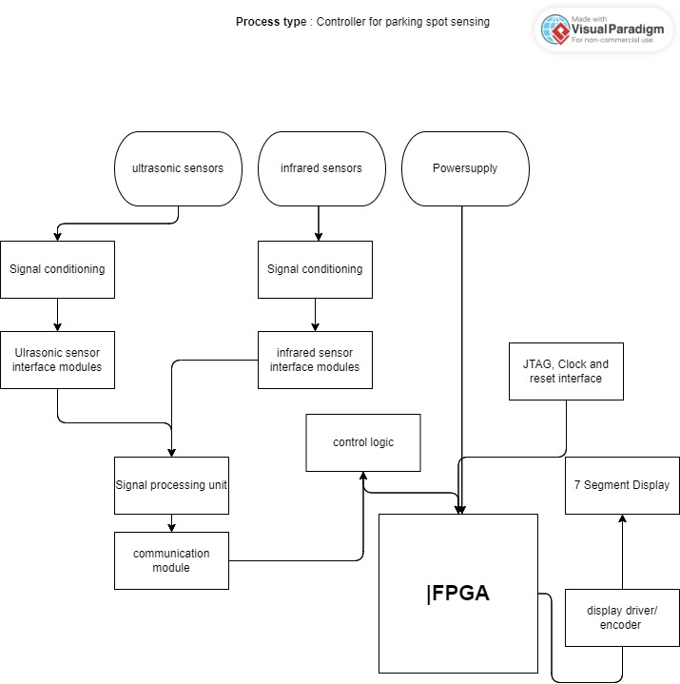
Components:
Ultrasonic Sensor
Infrared Sensor
Piezo-Buzzer
FPGA Board Nexys A7

Slide 5
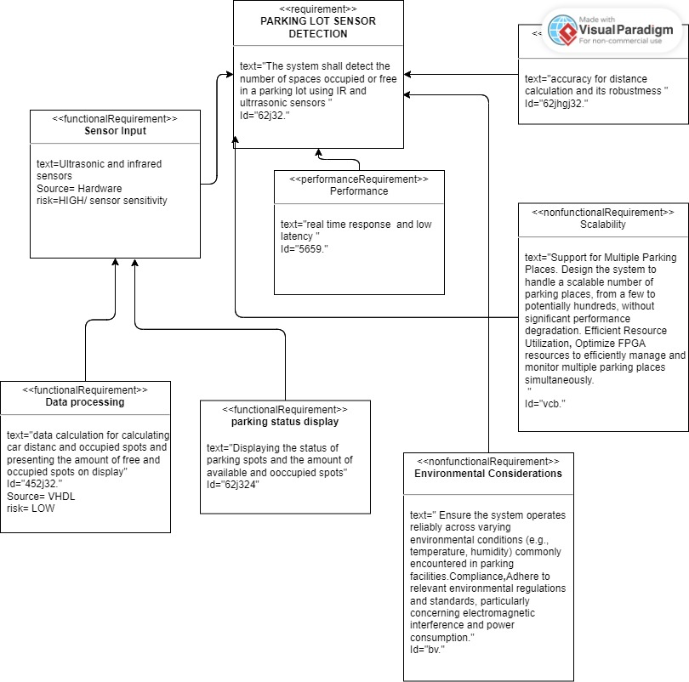
Functionalities:
Real-time surveying of parking spaces
Immediate display updates
Sensor data processing
Status display on 7-segment displays
Safe Distance alert via Piezo-buzzer

Slide 6
VHDL Coding and Simulation:
Coding:
Use of Finite State Machine (FSM) approach
Modules: Sensor check, status update, warning
RTL Simulation:
Test benches for simulation
Verification of design specifications
process(clk)
begin
if rising_edge(clk) then
if ir_sensor_input = '1' then
parking_status <= "1"; -- occupied
else
parking_status <= "0"; -- available
end if;
seven_segment_display <= parking_status;
end if;
end process;
process(clk)
begin
if rising_edge(clk) then
distance <= ultrasonic_sensor_reading;
if distance < threshold then
buzzer <= '1'; -- activate buzzer
else
buzzer <= '0'; -- deactivate buzzer
end if;
end if;
end process;

Slide 7
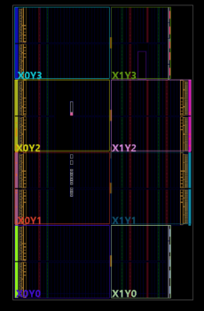
Synthesis Design and Implementation:
Implementation:
Successful implementation on Artix 7 FPGA
FSM-based control of system behaviour
Results:
Accurate status updates and collision warnings
Efficient and safe parking management system

Slide 8
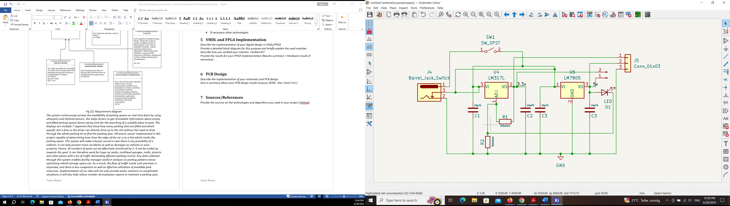
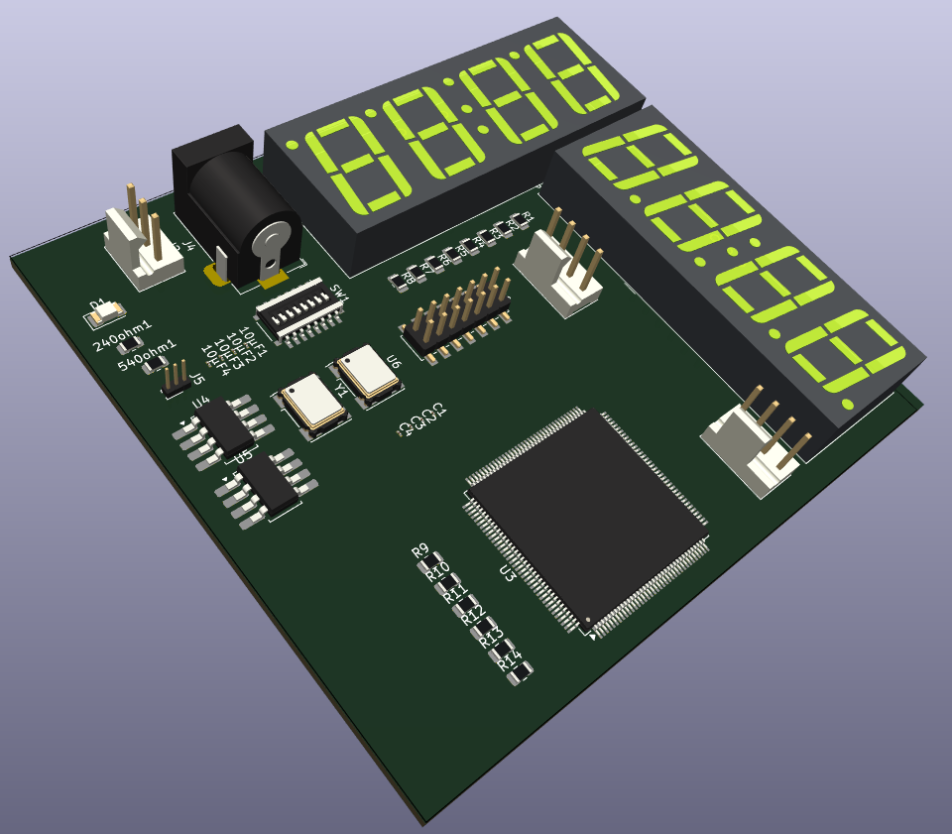
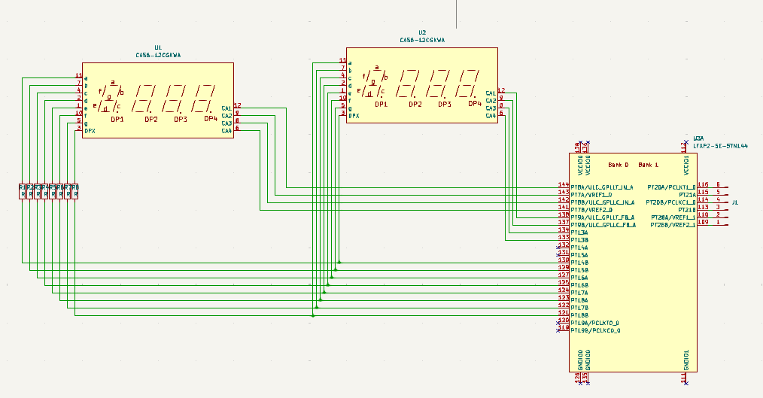
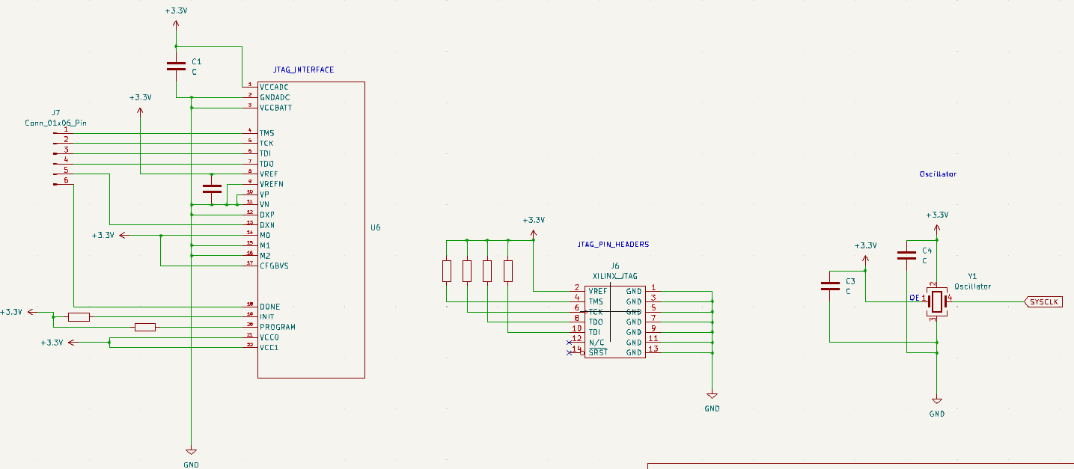
PCB Design:
Design Process:
Schematics development and component
ERC checks and corrections
Components:
Power Supply Circuit
Clock Circuit
JTAG Interface
7-Segment Displays

Slide 9
Conclusion and Future Work:
Conclusion:
High efficiency and accuracy in monitoring parking spaces
Real-time collision prevention
Future Work:
Integration with IoT applications
Scalability for larger parking lots

Slide 10
THANKS…

